Slide 1
DeadLocks

Slide 2
Deadlocks: A set of blocked processes each holding a resource and waiting to acquire a resource held by another process in the set.
Example:
System has two drives
P0 and P1 each hold one tape drive and each needs another one.
Ex:
Semaphore A,B initialized to 1
P0 P1
wait(A) wait(B)
wait(B) wait(A)

Slide 3
Deadlock Characterization:
Necessary Conditions:
A deadlock situation can arise if the following four conditions hold simultaneously in a system:
Mutual exclusion. At least one resource must be held in a non sharable mode; that is, only one process at a time can use the resource. If another process requests that resource, the requesting process must be delayed until the resource has been released.
Hold and wait. A process must be holding at least one resource and waiting to acquire additional resources that are currently being held by other processes.
No preemption. Resources cannot be preempted; that is, a resource can be released only voluntarily by the process holding it, after that process has completed its task.
Circular wait. A set {P0, P1, ..., Pn} of waiting processes must exist such that P0 is waiting for a resource held by P1, P1 is waiting for a resource held by P2, ..., Pn−1 is waiting for a resource held by Pn, and Pn is waiting for a resource held by P0.

Slide 4
Resource-Allocation Graph
Deadlocks can be described more precisely in terms of a directed graph called a system resource-allocation graph. This graph consists of a set of vertices V and a set of edges E. The set of vertices V is partitioned into two different types of nodes: P = {P1, P2, ..., Pn}, the set consisting of all the active processes in the system, and R = {R1, R2, ..., Rm}, the set consisting of all resource types in the system.
A directed edge from process Pi to resource type Rj is denoted by Pi → Rj ; It is request edge.
A directed edge from resource type Rj to process Pi is denoted by Rj → Pi; It is assignment edge.

Slide 5
Pictorially, we represent each process Pi as a circle and each resource type Rj as a rectangle. Since resource type Rj may have more than one instance, we represent each such instance as a dot within the rectangle.
The resource-allocation graph shown in Figure 7.1 depicts the following situation.
The sets P, R, and E:
P = {P1, P2, P3}
R = {R1, R2, R3, R4}
E = {P1 → R1, P2 → R3, R1 → P2, R2 → P2, R2 → P1, R3 → P3}
Resource instances:
One instance of resource type R1
Two instances of resource type R2
One instance of resource type R3
Three instances of resource type R4

Slide 6
Process states:
Process P1 is holding an instance of resource type R2 and is waiting for an instance of resource type R1.
Process P2 is holding an instance of R1 and an instance of R2 and is waiting for an instance of R3.
Process P3 is holding an instance of R3.

Slide 7
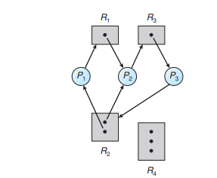
Two deadlocks
P1 → R1 → P2 → R3 → P3 → R2 → P1
P2 → R3 → P3 → R2 → P2

Slide 8
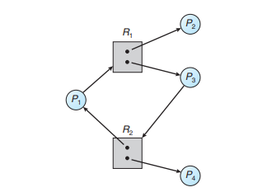
Resource allocation graph with cycle no deadlock
Cycle: P1 → R1 → P3 → R2 → P1
But there is no deadlock. Observe that process P4 may release its instance of resource type R2. That resource can then be allocated to P3, breaking the cycle.

Slide 9
Methods for handling deadlocks
Ensure that the system will never enter a deadlock state
Allow the system to enter a deadlock state and then recover.
Ignore the problem and pretend that deadlocks never occur in the system.
Methods for Handling Deadlocks
Deadlock Prevention
Deadlock Avoidance
Deadlock Detection

Slide 10
Deadlock prevention
Deadlock Prevention: we can prevent the occurrence of a deadlock if any one of four necessary conditions must not be hold.
Mutual exclusion : not required for sharable resources; must hold for nonsharable resources.
Hold and Wait: – must guarantee that whenever a process requests a resource, it does not hold any other resources.
Require process to request and be allocated all its resources before it begins execution, or allow process to request resources only when the process has none.
Low resource utilization; starvation possible.

